Slide 1
Transfer Learning
2019年春节学期
王津
2019-5-27

Slide 2
Outline
General Introduction to Transfer Learning
Features Extraction
Fine-tuning
Programming tasks
Transfer learning (Using VGG16)
Transfer learning (Using Inception)
Transfer learning (Using ResNet)

Slide 3
General Introduction to Transfer Learning
Transfer Learning
VGG、Inception and ResNet is only trained on ImageNet
They can be only predict 1000 pre-defined classes

Slide 4
General Introduction to Transfer Learning
Use state-of-the-art models to solve custom tasks.
Taking a network pre-trained on a dataset
And utilizing it to recognize image/object categories it was not trained on
Two type of transfer learning
feature extraction
Extract features to input into other custom models
fine-tuning
Put a softmax or sigmoid layer on VGG to adapt your tasks.

Slide 5
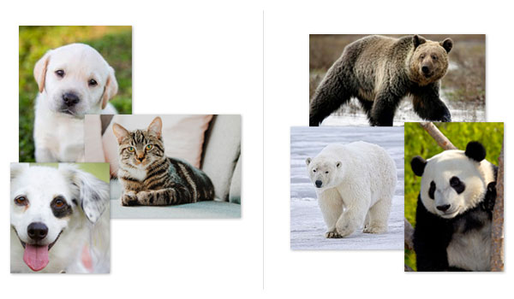
General Introduction to Transfer Learning
Cat vs. Dog -> Bear vs. Panda
First, we would gather a sufficient labeled dataset of dogs and cats, followed by training a model on the dataset
We would then repeat the process a second time, only this time, gathering images of our bear breeds, and then training a model on top of the labeled dataset.

Slide 6
General Introduction to Transfer Learning
Cat vs. Dog -> Bear vs. Panda
First train a Convolutional Neural Network to recognize dogs versus cats
Then, use the same CNN trained on the dog and cat data and use it to distinguish between the bear classes, even though no bear data was mixed with the dog and cat data during the initial training

Slide 7
General Introduction to Transfer Learning
Feature Extraction
Treating networks as arbitrary feature extractors.
Fine-tuning
Removing the fully-connected layers of an existing network, placing a new set of FC layers on top of the CNN, and then fine-tuning these weights (and optionally previous layers) to recognize the new object classes.

Slide 8
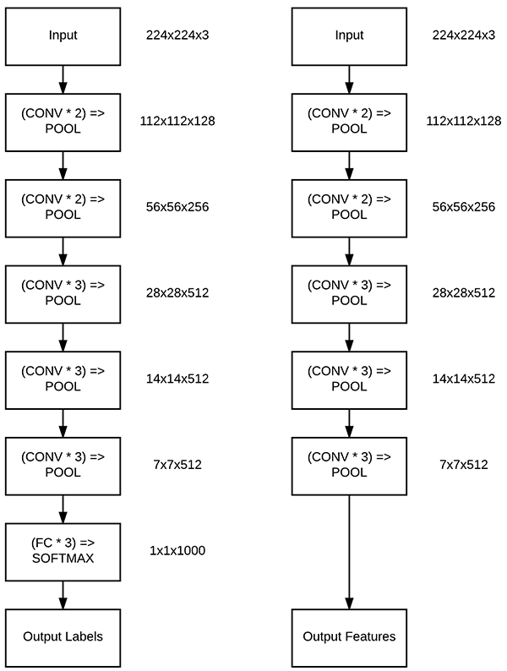
Feature Extraction

Slide 9
Fine-tuning

Slide 10
Keras – Transfer Learning
Include a pre-trained model
from keras import applications
# If you want to specify input tensor
from keras.layers import Input
input_tensor = Input(shape=(160, 160, 3))
vgg_model = applications.VGG16(weights='imagenet',
include_top=False,
input_tensor=input_tensor)
# To see the models' architecture and layer names, run the following
vgg_model.summary()

Slide 11
Keras – Feature Extraction
We still use cifar-10 as the training dataset
Resize image to (224, 224, 3)
Extract features
target_img = cv2.resize(x_train[0], (224, 224))
print(target_img.shape)
target_img = np.reshape(target_img, (1, 224, 224, 3))
print(target_img.shape)
from keras import applications
model = applications.VGG16(weights='imagenet', include_top=False)
print(model.summary())
features = model.predict(target_img)
print(features.shape)

Slide 12
Keras – Fine-tuning
Model definition – fixed layers
input_tensor = Input(shape=(32, 32, 3))
vgg_model = applications.VGG16(weights='imagenet',
include_top=False,
input_tensor=input_tensor)
# Creating dictionary that maps layer names to the layers
layer_dict = dict([(layer.name, layer) for layer in vgg_model.layers])
# Getting output tensor of the last VGG layer that we want to include
x = layer_dict['block5_pool'].output
# Stacking a new simple convolutional network on top of it
x = Flatten()(x)
x = Dense(256, activation='relu')(x)
x = Dropout(0.5)(x)
x = Dense(10, activation='softmax')(x)

Slide 13
Keras – Fine-tuning
Compile
# Creating new model. Please note that this is NOT a Sequential() model.
from keras.models import Model
custom_model = Model(input=vgg_model.input, output=x)
# Make sure that the pre-trained bottom layers are not trainable
for layer in custom_model.layers[:7]:
layer.trainable = False
# Do not forget to compile it
custom_model.compile(loss='categorical_crossentropy',
optimizer='rmsprop',
metrics=['accuracy'])

Slide 14
Keras – Fine-tuning
Training
Predict
custom_model.fit(x_train, y_train,
batch_size=batch_size,
epochs=epochs,
verbose=1)
y_pred = np.argmax(custom_model.predict(x_test), axis=-1)
print(precision_score(y_test, y_pred, average='macro'))
print(recall_score(y_test, y_pred, average='macro'))
print(accuracy_score(y_test, y_pred))
print(f1_score(y_test, y_pred, average='macro'))

Slide 15
Keras – Fine-tuning
Model definition – change layers
input_tensor = Input(shape=(32, 32, 3))
vgg_model = applications.VGG16(weights='imagenet',
include_top=False,
input_tensor=input_tensor)
# Disassemble layers
layers = [l for l in vgg_model.layers]

Slide 16
Keras – Fine-tuning
A new convolutional layer
new_conv = Conv2D(filters=64,
kernel_size=(5, 5),
name='new_conv',
padding='same')(layers[0].output)
# Now stack everything back
# Note: If you are going to fine tune the model, do not forget to
# mark other layers as un-trainable
x = new_conv
for i in range(3, len(layers)):
layers[i].trainable = False
x = layers[i](x)

Slide 17
Keras – Fine-tuning
Output layer
Compile
x = Flatten()(x)
x = Dense(256, activation='relu')(x)
x = Dropout(0.5)(x)
x = Dense(10, activation='softmax')(x)
# Final touch
result_model = Model(input=vgg_model.input, output=x)
result_model.compile(loss='categorical_crossentropy',
optimizer='rmsprop',
metrics=['accuracy'])

Slide 18
Keras – Fine-tuning
Training
Predict
result_model.fit(x_train, y_train,
batch_size=batch_size,
epochs=epochs,
verbose=1)
y_pred = np.argmax(result_model.predict(x_test), axis=-1)
print(precision_score(y_test, y_pred, average='macro'))
print(recall_score(y_test, y_pred, average='macro'))
print(accuracy_score(y_test, y_pred))
print(f1_score(y_test, y_pred, average='macro'))

